Slide 1
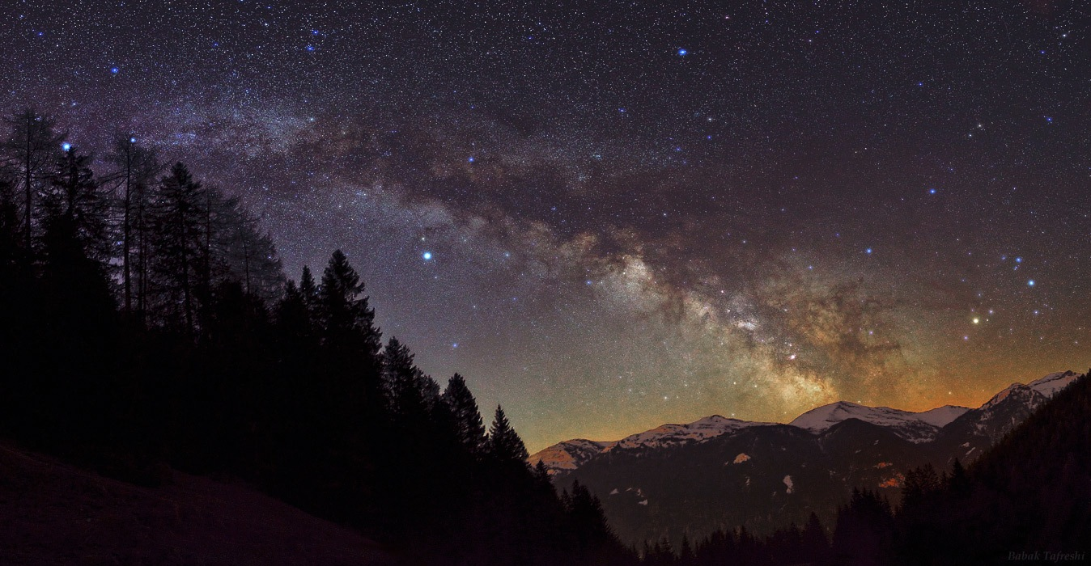
:
How decisions are made
insights from the review process,
what happens in the panel and reflections on successful proposals and applicants
pROFESSOR Haley gomez
IOP, Navigating the funding landscape 2016
Notes:
Hello everyone. Sara invited me to share some experiences with you about the reviewing process and what happens on a panel. I have experienced both sides of the panel process. I’ve had both failures and successes in applying for grants and fellowships, and I’ve also been a reviewer and a panel member for both fellowships and grant submissions for STFC.

Slide 2
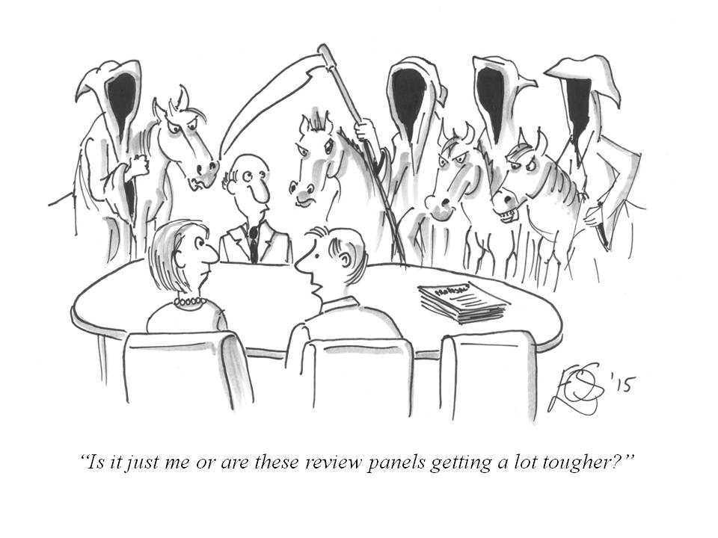
the grants panel
made up of Chair and expert panel members, with help from funding office
individuals grade proposals blindly based on pre-set criteria
proposals are ranked by the panel
panel makes recommendations for funding to funding bodies
Notes:
each panel will be different, but the process and (I hope) the professionalism I’ve encountered is the same. The panel are on your side , they want to fund excellent research and consistently wish to fund far more than they are able to

Slide 3
Who Gets Funded (IDEAL WORLD)?
Typically
funded
“Gray” Zone
Number of proposals
“Almost
Always
Funded”
Almost Never
funded
funding rates at ~10% fellowships, 10-15% ERC grants
Outstanding
Good
Fair
Poor
Excellent
Very Good
slide adapted from Richard McCourt http://slideplayer.com/slide/4567027/
Notes:
US NSF funding but principle applies on grants panels I’ve been on
In 2015 there were a significant volume of grants listed as excellent research which were not funded.

Slide 4
“a significant volume of excellent research cannot be supported”
2015 community report from the STFC Astronomy Grants Panel
Notes:
tell you this not to depress you but to really show that it isn't a personal failure if you don't get funding
I’m not going to use the words success and failure in this talk because the sad truth is that many very good science proposals are not funded - it doesn’t mean these proposals were not good, it means they were not the very best as judged by that one panel that one year against that year’s competition.

Slide 5
to apply or not to apply?
Stassun et al
Ted and Courtney von Hippel (2015)
Notes:
Stassun and his colleagues estimated how the amount of time spent writing grant proposals affects scientific productivity, by comparing the time that investigators take to prepare their applications2 to their chance of winning a grant and the average number of papers that a grant typically produces.
Ted and Courtney von Hippel (2015), who found that the average research grant proposal takes 116 PI hours and 55 Co-I hours to write and that the primary predictor of success is having had previous success.

Slide 6
STAGE I
The panel
STAGE IV
the panel meeting
STAGE II
external REVIEW
STAGE IV*
the interview
STAGE V
final outcome
STAGE III
PRE-PANEL meeting

Slide 7
STAGE I
The panel
Chair sets out criteria, rules and panel are reminded to be professional and to consider equality, diversity and be aware of unconcious bias
1st and 2nd introducers assigned to set of proposals within their area of expertise
1st introducers are in charge of leading discussion of their proposals at every stage including collating referees and applicant responses etc

Slide 8
STAGE II
external REVIEW
Introducer invites 2-3 reviewers (UK). ERC invites 8 reviewers. This means you are writing your proposal for:
reviewers - need very clear aims and how you will achieve the goals
the panel - make it easy for any intelligent but non specialist to grasp the importance of your proposal
Notes:
If the reviewers do not get the point about you and your proposal, you will lose despite being great, if they do get the point, then you’re on a level paying field with all the other excellent proposals.

Slide 9
STAGE III
PRE-PANEL meeting
You get a chance to respond to the reviewers - use this opportunity wisely
Panelists read all proposals + CV + all reviewer comments + all applicant responses (each one ~40 pages)
All panel members read and score all proposals offline
These scores are collated by funding office before face to face meeting
Notes:
response - be professional and concise - it can seem like a personal attack but don't take ti personally, the panel are on your side more than the reviewers are. this is actually quite rare.
believe me if you have got angry by a comment from a reviewer, then it’s likely that the panel will also be disappointed with that person and will disregard them. one of the reasons why we try to ask more than 2.
typically for each proposal this can be ~20 pages for UK (>60 pages European)
that’s 3200 pages to read, sift through and contextualise and then ultimately to rank

Slide 10
STAGE IV
the panel meeting
1st introducer leads discussion of their proposals
introducer has one breath to give title and strengths + weaknesses, gives initial scoring against set criteria
rest of panel invited to discuss and debate scores, final score decided by panel
this all happens very quickly
relative rank order of all proposals agreed by panel
Notes:
10 MINS!!!!!
also let me tell you this is definitely professional - if any panel member is trying to big up their mates, or put down someone they don't like or act inappropriately, then the rest of the panel comes down on them.

Slide 11
Time for reflection at the end to compare ranking of all grants and ensure no glaring issues
Different chairs act differently, some start bottom up, others top down
More time given to proposals in grey area, less on graded poor or outstanding
Panel also take time to reflect on what went wrong, right, could be improved for next round
Notes:
Examples: grants on final day all lower than the rest statistically suggesting grumpy panel etc, sub areas ranked lower on average (theory vs experiment etc)
chair also checks panel members are also doing a good job of ranking the proposals i.e. not too harsh, too soft since this can skew the results. Had one example where a panel member scored all 35 applicants between 8 and 10 out of 10, so when it came to judging which ones were the top 10% it was impossible to take their scores into account. they were asked to re-rank their list.

Slide 12
STAGE V
final outcome
The introducer will write feedback taking account the reviewers and panel’s thoughts - often couched in strengths + weaknesses
If funded, details on funded resources are provided
If unfunded, might say whether panel thought grant was fundable (ie good+) or ranking (which tercile etc)

Slide 13
FELLOWSHIPS
Same as the grants panel process but with an extra sifting meeting by experts or triage process
More emphasis on you and track record
why you, why now
what makes this proposal likely to work
leadership potential
Notes:
in STFC we have a small sub panel made up of ~4 people per 30 applications which review and rank all applications taking account the reviewers comments, the applicants responses and their own questions/criticisms of case. They in fact provided strengths and weaknesses as well as remaining questions for the interview stage.
triage - cut already done based on reviewers
therefore there is an interview stage
if you get to interview, the cut tot get to this stage is very harsh already so panel are fairly sure about the science being ok, unless it becomes clear at interview that you didn't write the case! the purpose of th interview is to whittle down excellent cases into the ones that show the most potential for future leaders of the field, who do we think might lead the next big mission, or is fast becoming the expert on X ad Y. Who do we think are going to continue to do excellent science.
at this point try to get across the following….(slide)
and be prepared to blow your own trumpet though get the balance right. no-one wants a car salesperson but we also want to see evidence of your leadership (PI of telescope proposals. 1st author papers, )

Slide 14
STAGE IV*
the interview
Usually 10-15 mins for talk (that’s not very long!)
15 mins for QNs, typically split into science (led by introducer) and on broader career/impact
panel expertise is very broad
Do a mock interview with your department
Find out about the panel members, know your audience
Notes:
, panel are not attacking you
The most important thing is to convince the rest of the panel that your work is important, so make sure the opening 3 mins really sell it without coming across too over the top or inflated (no-one wants a car salesperson !)
When I interviewed for a European grant, no information existed about the panel and I had to give a 10 min talk on my proposal for 1.8million euros. they put us in a room with all the other people shortlisted for the grant for many hours before the interview (that on it’s own is torture) and then the interview room had 16 people in it and I knew none of them. I had 10 mins which woks out at 180,000 euros per min. They all looked extremely bored and to be frank, I genuinely got the feeling that they simply didn't care about my proposal. I now know that they were simply very tired of listening to 15 talks before me…
the mock is an excellent way to get practice and some experience in what to expect, now many people have said that the mock was much harder than the real thing but this is a good thing, when panel are looking for the next leaders or potential new academics in their field, they don’t want to see people who are easily flummoxed or cant answer questions in a professional and calm way. I’ve seen people get so stressed about a simply question on where they think they’ll be in 5 years time that their entire interview falls apart from then on. Also know your audience, what’s their expertise and what is the fellowship for. the mock is an excellent way to think of they type of questions you may get in advance
I once saw an interview for a fellowship that was by design to find the next leaders in UK science (and which was known as basically a fast track to a permanent UK academic position). when asked where did they see themselves in 5 years time, they responded with “Germany” . Needless to say that didn’t go down well with the panel. If you’re going to talk about collaborating with so-and-so from University of Poppleton and the Head of the Poppleton physics department is on the panel, you better know the correct name of the collaborator. This kind of research takes no more than an hour’s work and yet will provide you with (a) a safety net and (b) will undoubtably impress the panel with your superior knowledge
If you can demonstrate you're not only going to exploit instruments in which the UK and STFC have already supported/invested/created but also use them to address high priority STFC science challenges, then you're
onto a winner.
after the interview, each panel member grades every candidate blind and they are compiled by the office. the office then put all grades up for everyone to view with the rankings. the chair of the meting moves down the list and each case is discussed once more as an open room, and panel members are invited to change their ranking fi they felt they had got it wrong (Eg not in their expertise so they ranked it too positively or negatively). Again, scores with high deviation are discussed in more detail, as are proposals on the borderline of fund-unfund.
breathe and think before responding to questions, they will respect that rather than a rush of answers that make little sense because of nerves.

Slide 15
EXAMPLE QUESTIONS
What piece of work are you most proud of?
What is the next big thing in your field?
Who else is doing this (who are the direct competitors)?
Where do you see yourself in 5-10 years time?
What impact does your work have on the wider community?

Slide 16
insider tips: what makes a good application?
your proposal
spent time and care
ambitious ideas, timely
logical flow from
aims goals methods
tells a story
proof read and well written
all the things you want to put in
Notes:
Complete all the boxes, we often see that people don't read things properly - e.g. a specific box in fellowship application that asks for top 5 papers and their citations, and this isn't always included- this is important as when judging track record, panel and reviewer wants to see what your highest impact papers are and where you are on the author list… so the reviewers and the panel members have to spend more time trying to dig this information out which immediately starts making it harder for us to concentrate on the excellent science your proposing
here’s a massive piece of advice: spell check or get someone to read over the proposal. typos and errors in the text are a major source of aggravation for the panel and reviewers and can cause a proposal to be chucked on bottom of pile, remember with only 7-15% funded, the panel needs to discriminate somehow and this is asking for trouble.
although in an ideal world we wouldn't care abut the typos and just care about the science think about it tfrom the point of view of the panel. in fact i’ve been in a situation where I’ve been asked to put through only 4 proposals to interview from ~35 where the majority of the proposals are actually pretty good science. this is a hard thing to do, and this naturally makes me a little grumpy. Reading a proposal that is very poorly written or shows lack of effort/care definitely does not help. There’s also a good correlation between applications with typos or missing references that are also very dense - where the proposal aims are not clear and where it is difficult to even figure out how those aims will be achieved. Imagine yourself in the panel’s shoes. Why should they have to rewrite the proposal for you, and if you’re applying for a fellowship (typically 500K) then showing you can use spell check is important.
the good news is that all these things are easy to do - yes they take time but they are under your control and are easy to fix!
have clearly revised what makes a good submission (ie looked at other proposals)

Slide 17
insider tips: SPECIFICS
Message in title, abstract, figures and opening paragraph (elevator pitch)
Don't be passive, instead assert-justify*
Included quantities not vague statements throughout
“doing X will allow us to test theory A and B”
Figures and schematics clear and used effectively
Learn from proposals that have been funded before
*see http://www.researchfundingtoolkit.org/blog/
Notes:
The message has to be in the title, in the abstract, in the figures, in the diagram, in the examples.
If your project on “Interstellar feedback models and regulating inflow cycles in NGC4501" cannot be motivated in plain English, don't expect the particle physicist panel chair to pitch it against “Detecting the Higgs Boson” or “Understanding the first seconds after the Big Bang using gravitational waves”
When telling them why you and why now, try to be specific in exactly why this project will move field forward and avoid "we" and passive statements like "I aim to" -- you should be direct and say "I will do" etc. One example of a good kind of statement is: "new instrumentation X provides Y times better resolution at Z wavelength which allows us to pinpoint the radial distribution of A for the first time. This will allow us to test theory B which predicts C which currently cannot be tested". This kind of thing is much stronger than vague statements like "we will use a new instrument to solve these issues". Also try and link your work to areas outside the immediate field ie can your technique/results be applied to help understand galaxies or stellar evolution etc etc.
we have a wiki where all proposals are put online for everyone to see. if you know anyone on the panel chat to them for pearls of wisdom (though don’t expect them to review since they already have 100s of cases to read and it’s a bit of a conflict of interest) - FIND OUT WHATS AVAILABLE IN YOUR DEPARTMENT, BETTER YET GET A MENTOR

Slide 18
insider tips: what makes a good interview?
practice: clear delivery of talk and well timed
ensure even non experts understand your proposal
include quantities and specifics not vague statements
nice clear figures with big labels
demonstrated leadership
Calmly thought about and responded to questions
Notes:
back up statements with facts

Slide 19
final comments ON THE PROCESS
chances of funding small ~7-15%
make the job as easy as possible for the panel because they have little time in which to make difficult decisions
you cannot control some factors like competition
don’t take rejection to heart - try to learn from the feedback
use already funded proposals as a guide
Notes:
rejection does not mean you and your science case is not good
not perfect but definitely high integrity - no-on is happy when they see the final list of who gets funded or not, we know there’s a lot more excellent research out there
writing grant proposals can be a nice idea that turns into papers even if not funded…

