Slide 1
Developing an effective relationship with your supervisor -Glasgow University Nov 2015
Dr Sara Shinton
Shinton Consulting Ltd
www.shintonconsulting.com

Slide 2
Outcomes for today
Understand researcher & supervisor roles
How to manage the supervision process
Provide strategies to help you be effective
Know where to get more help & guidance
www.shintonconsulting.com/universities/Glasgow-Arts
www.shintonconsulting.com

Slide 3
A useful model?
Abraham Maslov
Human Motivation and Personality

Slide 4
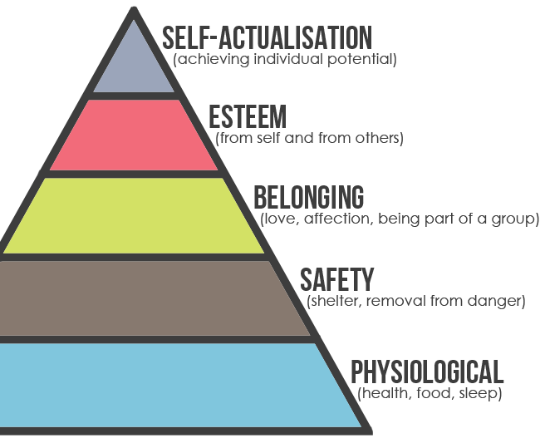
The Hierarchy of Needs
Motivators
De-Motivators

Slide 5
What would a supervision model look like?
Self actualisation - project ownership,
control of future career
Esteem - respect & trust of supervisor
Belonging - access to community &
Opportunities
"Minimum expectation" - feedback
& availability for meetings
"Contractual" - research
infrastructure & facilities

Slide 6
Supervision model
Not static
Freedom to supervise within guidelines to own model
Is your supervisor’s model clear to you?
www.shintonconsulting.com

Slide 8
Roles and responsibilities
What should a PhD research student take responsibility for ?
What should a supervisor take responsibility for ?
Discuss in your groups the range of activities that make up these two roles.
www.shintonconsulting.com
Notes:
Give them about 5-7 minutes – if they are still actively chatting give them a little extra time.
Go around the groups and get a few points from each until they have all contributed, then ask people to add anything extra
Usually they come up with a great list – worth asking them if they have discussed this with their supervisor and got their agreement.,

Slide 9
Roles and responsibilities - Student
conduct original investigations
test ideas
understand context of the work
make sure everything relates to core themes
identify and learn necessary techniques
keep accurate and up to date research records
regularly review own timeline
get involved in research community
learn how to discuss ideas openly
listen to supervisor !
become more professional…
ie do the work !
www.shintonconsulting.com

Slide 10
Roles and responsibilities -Supervisor
be interested in you and your research
be available for meetings
ensure the final goal is realistic and identifiable
help with networking
support involvement in wider research activities
assess progress objectively and provide honest feedback
encourage open discussion of ideas
challenge you
set a standard to follow
You’ll need to now discuss the differences between this and the previous list and also different perceptions – a supervisor’s idea of “guiding with encouragement” may involve a lot of criticism in order to improve your performance. As a student you can sometimes feel like you only hear constant negative feedback so you need to ask for positive comments as well.
www.shintonconsulting.com
Notes:
You’ll need to now discuss the differences between this and the previous list and also different perceptions – a supervisor’s idea of “guiding with encouragement” may involve a lot of criticism in order to improve your performance. As a student you can sometimes feel like you only hear constant negative feedback so you need to ask for positive comments as well.

Slide 11
Griffith questionnaire
The website will link to the Griffith questionnaire that can be used
as a good basis to identify where you see your role
& your supervisors role & any gaps/differences.
www.shintonconsulting.com

Slide 12
Negotiate how you will work together
Overall plan & deadlines
Time/frequency meetings
Involvement in research seminars etc.
What skills & training
Feedback when?
Regular writing or draft?
Availability of supervisor
Career development
www.shintonconsulting.com

Slide 13
Your 3 year PhD
0
6
12
18
36
competencies
On top of literature
Skills in place
Project mapped out
Ideas emerging
Apply & develop method
Feedback
Debate ideas
Practice research
See need
Tune in
Methodology
Familiarisation
Professionalism
Independence
Contributing
Confident
Ambassador
Areas to think about to develop during during 3year PhD
www.shintonconsulting.com
Notes:
Using flip chart draw line across top in months 0-36
How are you going to develop your 1st 6 months?
The competencies that you are going to need?
Professionalism
Groups of 4 15mins to share

Slide 14
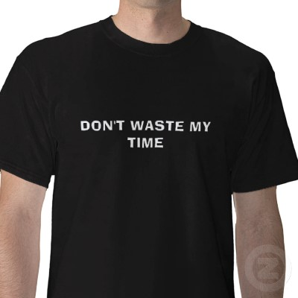
Reality check!!
Academics not necessarily endless source of advice support & guidance
May have different priorities & timescales than you do
Will be extremely busy
Will want your leadership!!
www.shintonconsulting.com
Notes:
Academics not necessarily endless source of advice support & guidance
May have different priorities & timescales than you do
Will be extremly busy
Will want your leadership!!

Slide 15
See Moodle site
http://www.gla.ac.uk/services/postgraduateresearch/pgrcodeofpractice/
www.shintonconsulting.com

Slide 16
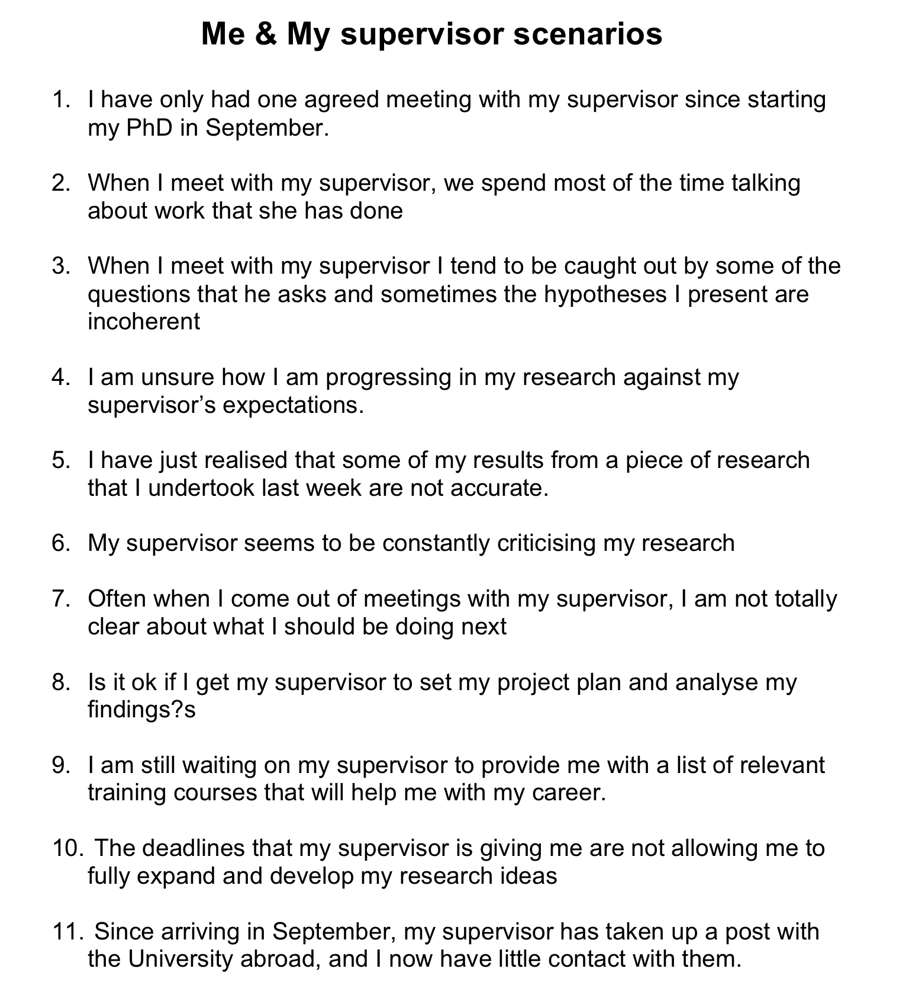

Slide 17
Basis of these problems ?
False expectations
Lack (or breakdown) of communication
Failure to see big picture
Personality clash
Different preferences…
Other pressures
www.shintonconsulting.com

Slide 18
Overcoming problems
Keep things in perspective
supervisor is human
shares your long term goal (completion of degree)
may criticize your actions, not you
Be organised
prepare for meetings with points for discussion
record decisions made
Be honest
report any mistakes (before the grapevine)
report on difficulties whilst they are SMALL
www.shintonconsulting.com

Slide 19
Overcoming problems
Be professional
can’t always expect to get on with all colleagues
heed advice from more experienced researchers
Ask for feedback
and don’t wait to be told what to do or read
Meet deadlines
Show your enthusiasm
Communicate !
www.shintonconsulting.com

Slide 20
What if relationship breaks down
Step back, identify what is making it difficult to work together
Get objective outside perspective by someone you trust
Ask any fellow students (you trust) if they have had any similar experiences – be discrete & tactful.
Try to maintain communication as much as possible
Build up a network of colleagues for informal feedback
Finally discuss concerns with director or head of department
www.shintonconsulting.com

Slide 21
Useful behaviours
Transparency
Identify your supervisors rules & make your expectations clear
Communication
Take responsibility, but expect availability
Consistency
Accountable
Distance
Professional, basis for management
www.shintonconsulting.com
Notes:
Useful behaviours
Tranparency
Identify your supervisors rules & make your expectations clear
Communication
Take responsibility, but expect availability
Consistency
Accountable
Distance
Professional, basis for management

Slide 22
Meetings?
PhD is about:
Training - so progress must be monitored
Developing opinions - which need to be tested against experts
Seeking other views - usually face to face
Disseminating contribution
….much of which occurs in meetings
© Shinton Consulting Ltd 2011
www.shintonconsulting.com

Slide 23
Effective meetings
Are structured meetings
address common problems
Give you a chance to practice your hypothesis & defend your work
Help plan for the future
www.shintonconsulting.com

Slide 24
Good questions to ask you supervisor
Have you seen any good ways of organising my research/reading notes?
I have looked at these funding agencies. Are there any other funders that you suggest I apply to?
I have worked out a rough timetable for the next month. Does it look realistic to you?
Can you clarify key deadlines?
Am I on track with my work?
What is the assessment criteria for being assessed for a lecturing post?
What do you expect to see from me in 3 months time?
Are there examples of good writing that you rate?
What are the assessment criteria for the transition review?
Who would it be useful for me to meet/know?
Are you happy with my work/progress/anything I’ve done?

Slide 25
Support
Glasgow
http://www.gla.ac.uk/media/media_101031_en.pdf
Head of Department or Centre
Research and Graduate College
Student Welfare
Student Counselling Services
www.shintonconsulting.com

Slide 26
Top tips
Care & maintenance of your supervisor
Meet regularly
Discuss & negotiate
Understand different styles
Write & show as you go
Forces you to stay on track
Set deadlines. Focuses the writing
Write journal articles as you go
Practice writing with your peers
Its not a Nobel prize
You are learning
Stay focused
Your PhD is a bunch of thoughts on paper, its not you!! Put it in perspective
It’s a job. Work 9-5 but with holidays
Set up your workplace
Take time off
Set deadlines & targets
Get and ask for help
Allowed help
Use the university staff
www.shintonconsulting.com
Notes:
Care & maintenance of your supervisor
Meet regularly
Discuss & negotiate
Understand different styles
If it is not working do something

Slide 27
Final thoughts
Attitude and realistic expectations
Consider yourself as a research professional in training, rather than a student
Strive for respect as a valued research colleague through a mature approach
Remember that a PhD is a 3/5 year project and a path to your next career stage
Enjoy your PhD !
www.shintonconsulting.com

Slide 28
Vitae
Researchers’ Portal (www.vitae.ac.uk) free resources & information for all PhD students:
PhD Planner, Just for Postgrads, PG Tips
GRADschool courses for 2nd and 3rd year PhDs
National GRADschools: free for Research Council and Wellcome Trust funded PhD students
www.shintonconsulting.com
Notes:
is funded by the UK research councils:
Amongst the support it has to offer is
free resources & information for all PhD students on the website
PhD Planner, Just for Postgrads, PG Tips
GRADschool courses for 2nd and 3rd year PhDs
National courses free for Research Council and Wellcome Trust funded PhD students
Local Edinburgh GRADschools open to all

Slide 29
Additional links
http://www.academiccareer.manchester.ac.uk/ - academic career advice and development
http://www.apprise.ox.ac.uk - research development practice “This website is for those who are studying for a doctorate, or who are in the early stages of developing a career beyond their PhD. It aims to demystify the PhD process and give you opportunities to reflect on your academic practice.”
www.shintonconsulting.com

