Slide 1
Fellowship funding
Heriot-Watt University, February 2016
Many of the slides here were not shown during the session as we focused on answering individual questions. However, they are included for information

Slide 2
Resources
All links are on the web….
www.shintonconsulting.com/postdocs/fellowships

Slide 3
Overview
Themes:
- benchmarking
- long term research vision
- certainty and aspiration
- funder DNA

Slide 4
Who?
Alex Peden
Sara Shinton
You:
Research Interests
Funder/s of interest (scheme if known)
Questions you’ve come with

Slide 5
Why?
Funding landscape is complex
Best advice is in experts' heads (but this can aggravate unconscious bias)
Competition for fellowships is fierce, but long term planning and support will make a difference

Slide 6
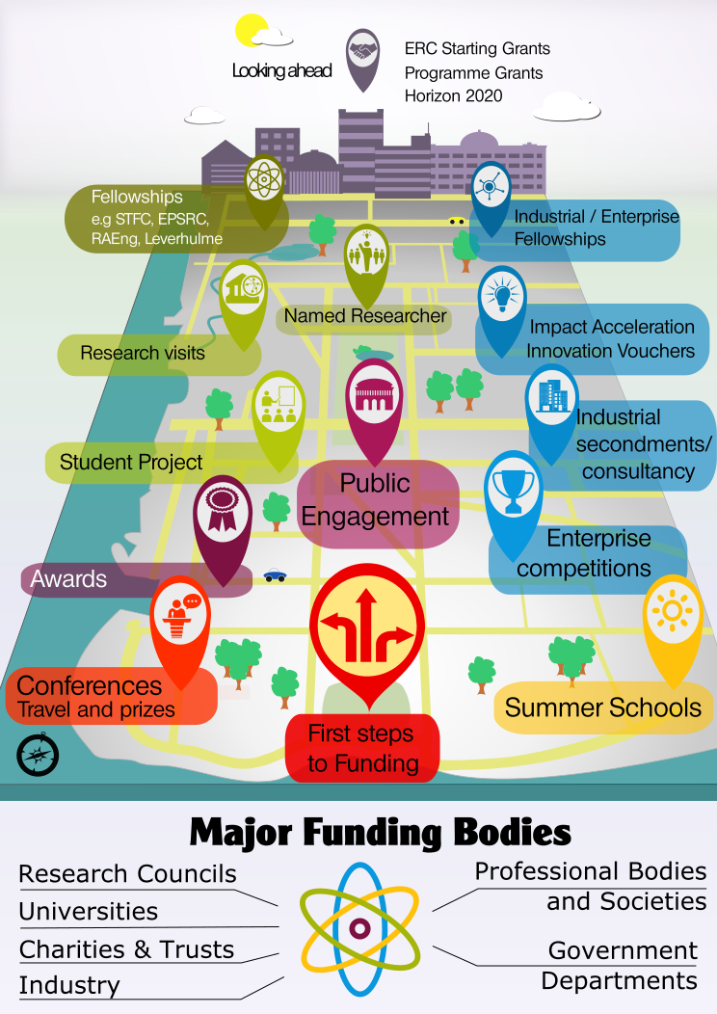
Illustration by Miriam Gilbert
@MiriamRGilbert

Slide 7
Who funds Fellowships?

Slide 8
Key funders by type
Government
RCUK
Partnership initiatives
MSCA, ERC
Universities
Commercial
Diverse industrial base
International relevance
Charity and trusts
Royal Society

Slide 9
Key funding
by theme
Individual development
Workshops
Conferences
Secondments
Travel and visits
Fellowships
Research funding
Projects and programmes
Fellowships
Challenge-led
Societal Challenges
Industrial collaboration
Early career researcher
Established researcher
Early career researcher
Research Leaders,
some ECR
Early career researcher

Slide 10
Illustration by Miriam Gilbert
@MiriamRGilbert

Slide 11
Culture and mission
Government
Development of science base
Skills shortages/opportunities
Economic or societal benefits
Commercial
Solving problems with different approaches
Focus on market and profit
Charity and trust
Societal
Filling gaps
Often individual focus

Slide 12
Digging deeper
Write and SHARE
Applications & reviews
Experienced applicants
Websites, publications, funding trends

Slide 13
Talk to funders
Go to their events
Email programme managers
...and talk to Alex today!

Slide 14
Benchmarking
Comparing yourself to your peers and competitors
Will be “done” to you each time you apply for funding, particularly for fellowships, so “do it yourself” now

Slide 15
Benchmarking
What have your learnt from benchmarking?
Into pairs,
Discuss features of successful applicants
Think about what enabled them to achieve what was on their “CV”
Be ready to feedback
FIVE key points, identifying one area of focus for each of you
Any areas needing institutional/network support

Slide 16
Your research vision
What is your ten year plan?

Slide 17
What do you want to be known for in ten years?

Slide 18
How will you demonstrate this is achievable?

Slide 19
My thoughts
Insights into funding trends
you know where the money will come from
Evidence of relationships which could develop
collaborations will be key
Signs of credibility
reputation and visibility – a “name”
Evidence you deliver
worth the risk of investment
track record congruent with ambition
Impact – academic and societal/economic
21st Century view of academic research
Leadership
You make things happen, create opportunities, defining the area, key publication

Slide 20
Balancing certainty and aspiration

Slide 21
I can do this because….
I’m doing it already
It’s a natural progression and the foundations are laid
I have the right
network and offer
complementary
expertise
I’ve demonstrated I
can deliver in similar
situations

Slide 22
What are the elements of your vision/research plan? What evidence will you present that you can be trusted to deliver on them? Who needs to support your vision?

Slide 23
Making a plan

Slide 24
What convinces the panel someone is in the top 5%?
5%

Slide 25
Combination of factors
Person
Time
Project
Place

Slide 26
In their shoes
Funders always have an objective
If they think you are going the help them achieve this, they are more likely to fund you

Slide 27
Plan starts with...
Strategy to understand the funder....

Slide 28
How does your proposed project fit with your proposed funder?
Imagine them standing in front of you with a chequebook – why should they give you THEIR money?
Not just about you – about them as well
How will this project boost your career?
Why are you the only person who can do it?
Why is it a “good risk”?

Slide 29
Provide evidence
Funding research is risky
Funders want to minimise risk where they can
Evidence of successfully turning research funding into outputs helps them believe and trust you
Make sure your ambitions match your track record

Slide 30
Plan develops with...
Clarity about criteria you will be judged against
Evidence you are the right applicant
Present a confident and fluent case for investing in you

Slide 31
Why me?
X years experience
invited talks
patents or impactful publications
well connected
unique combination of industrial/research approach
unique combination of skills, knowledge, techniques
record of delivery
Objective of fellowship is to invest in talent

Slide 32
Demonstrate the need
Time
Funders fund researchers and research
Why is your research needed?
Why now?

Slide 33
“Good” risk
previous experience
novel, high impact work
no-one else making significant investment
high chance of commercial investment when complete
room to grow a group around you
bring skills or knowledge to UK
high visibility in society
Funder
subject directly in funder’s
hot topic list
roadmap industry
Objective of fellowship is to target funding strategically

Slide 34
Plan must include...
Case that supports your claim that this work is important
Evidence from stakeholders that the work has value and you are the right person to do it

Slide 35
With these ideas in mind
Get into groups - suggest two groups per table
Come up with a list of five things that would boost an application in 12 months time
I'll share my ideas after

Slide 36
Publish, with focus on high impact
Write a review article
Demonstrate that the idea will work – proof of concept
Raise personal profile and recognition across subject
Look for committees to join, meet potential reviewers
Approach potential reviewers
Go to the right conferences, go to seminars
Get some smaller grants and awards
Start to develop leadership – supervise UG, Masters, PhD students
Bring international people here
Contribute to institution
Seminar programme
Teach on masters?
12 month plan

Slide 37
Secure more funding, do some pilot work, establish proof of concept (POC)
Build a plan/case for larger scale research
Build a group – identify students (get them working on POC)
Deliver to agreed milestones (establish credibility)
Collaborations – with other institutions, international, industrial
Start up commercialisation
Publication and patents
Get some training
Build independence
24 month plan

Slide 38
6 month plan
Be SEEN at conferences
Get your data out there
Write a review
Produce a good webpage – personal site if necessary (buy domain), blogs, social media
Be invited for seminars (approach organisers or departmental programmes)
If looking for funding for a charity look for ways to support them – fundraise?
Write a position paper – statement of intent
Get your papers out and connect with others (cite their work, email them PDFs, find short-term collaborations for papers)
Join (or start your own) subject network – get network development funding

Slide 39
Fellowship interviews

Slide 40
The ethos of fellowships
Person
Time
Project
Place

Slide 41
Internal Review and Selection
External Review and Response
Panel interview and presentation

Slide 42
What do they want to see and hear?
In small groups
Quick summary of what you've heard and what you think this means about the characteristics of a strong candidate

Slide 43
What are your key messages and convincing arguments?
Individual activity
Five minutes to write down the key points about your idea
If you were about to meet the funder, what MUST they know about you before they make the decision?

Slide 44
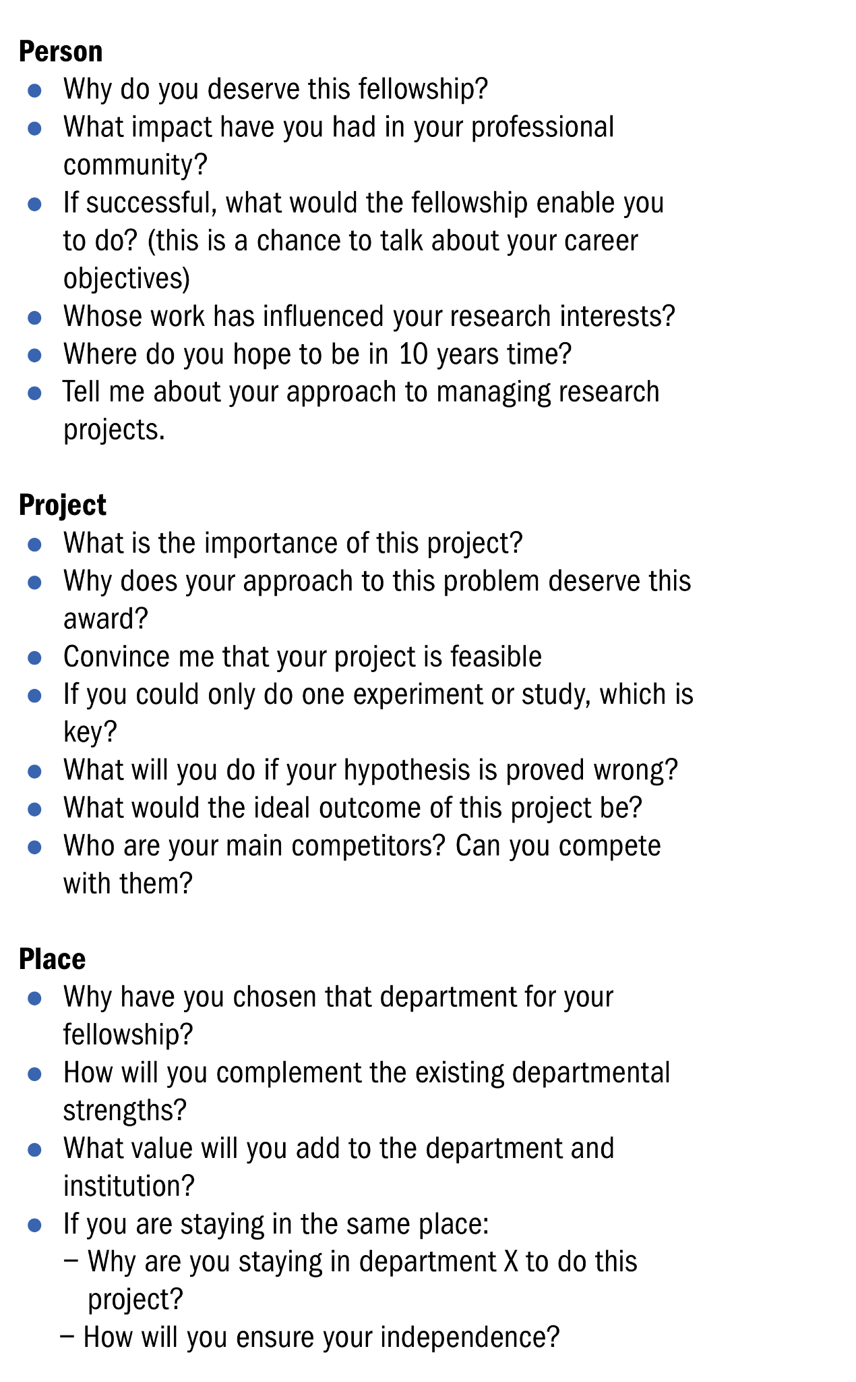
Time
Who else is active in this field & how does your work differ?
What are the risks of not funding you immediately?

Slide 45
Mock interview time...
What funding are you planning to go for?
Conference or visit?
Fellowship?
Project?
Industrial?

Slide 46
Key messages
People have the answers
It takes time (longer than you think)
You will face rejection
But...you can reduce your rejection rate with good preparation

