Slide 1
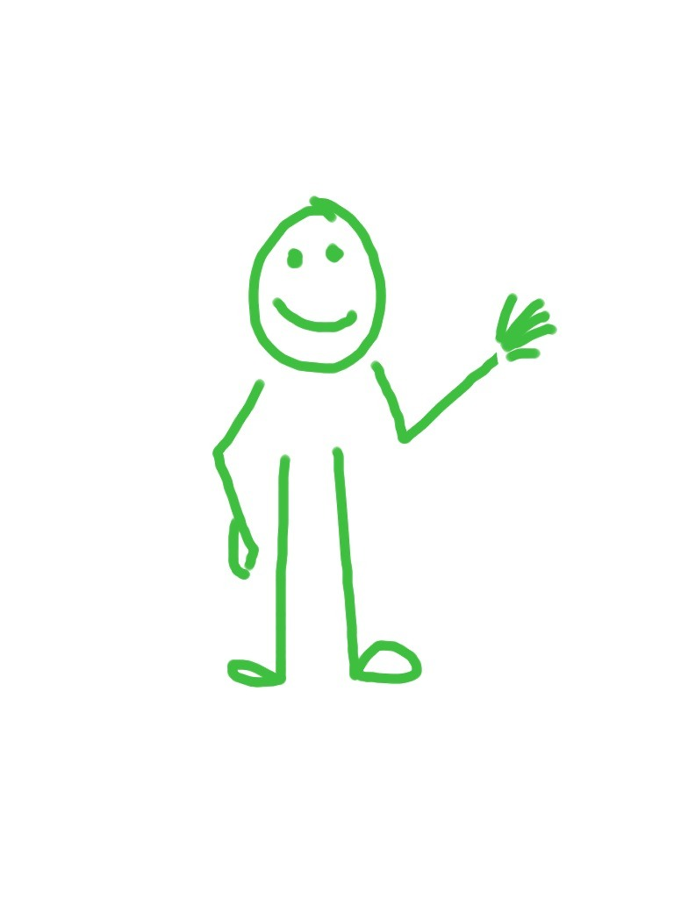
Dr Sara Shinton
Welcome to Confident
Networking!
Dr Sara Shinton
www.shintonconsulting.com
Notes:
Welcome to the session – workshop has been developed for UCC.

Slide 2
PhD & Postdoc Physical Chemistry Teaching Assistant Careers Adviser
Founded Shinton Consulting in 2000
Researcher developer
Business woman
Networker
Notes:
A little background about me. My career has depended on networking..
As a PhD student a major breakthrough in my research came about through a conversation at a conference
I got my first non-research job after working out who was best equipped in my department to give me advice – and by asking them for help
As a careers adviser I built a network of peers and employers to enable me to give better advice to students
And as a small business owner I must be visible, memorable and effective. I don’t advertise or market my company, so networking is a key tool in building and maintaining my reputation.

Slide 3
research area
motivation
questions
hello
my name is…

Slide 4
Notes:
Some people find networking easy, others find it hugely challenging.
What we will try to do today is to identify the good habits of natural networkers and to apply them to ourselves.
We’ll try to identify out own weaknesses and concerns and find comfortable ways around them.

Slide 5
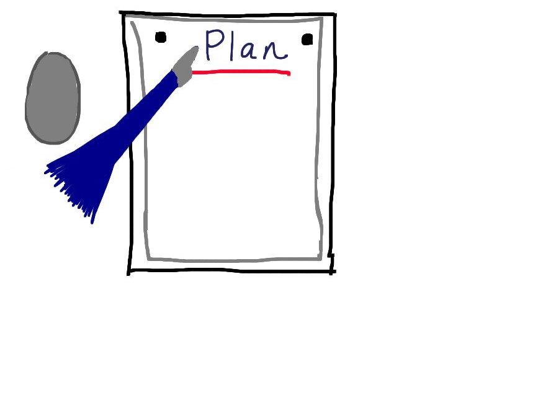
Notes:
The four main areas we’ll cover today – looking at the good habits I mentioned earlier and how technology can help to take some of the sting out of networking

Slide 6
NETWORKING – IT’S REALLY IMPORTANT AND SCARY!
Actually, it’s just about talking to people. You do it every day…
Notes:
I want you to stop feeling like this. If you think of networking in terms of being “something” it becomes more intimidating.
Don’t think about going to places to network. Just go to places.
Don’t think about people you need to “network” with – just think of people you might be interested in hearing more from
Don’t think of it as something MAKE OR BREAK – just a moment in time where something might happen or something might not

Slide 7
What are your personal barriers to networking?
Take a moment to note your own, then share with someone...

Slide 8
Common barriers
Build your cultural awareness by talking to people from different cultures
You might also get some tips from cultural experts such as: http://www.geert-hofstede.com/
Cultural differences – not knowing rules of different societies and attitudes to small talk/direct questions/speaking to strangers!
The awkwardness of starting conversations
Knowing what to say
Feeling intimidated by people who know more stuff than me (and them making sure I know they know more stuff than me…)
Talking to people with more status than me
Saying something stupid
Insecurity
Feeling I HAVE to network

Slide 9
One I still experience….
The awkwardness of
starting conversations

Slide 10
What does our natural networker have?
A ready supply of questions interesting facts, observations, charm

Slide 11
Situational Motivational Functional

Slide 12
Situational Motivational Functional
Let’s get comfortable talking to each other
Are you like me?
Let’s find out more about you and decide whether to take this further

Slide 13
“The awkwardness of starting conversations”
Good habits from natural networkers – a supply of great questions to open conversations.
Situational questions (about the environment or shared experience) Let’s get comfortable talking to each other
Motivational questions (explore the values or attitudes this person has) Are you like me?
Functional questions (understand this person’s knowledge, skills, contribution) Let’s find out more about you.
These questions develop and emerge during the conversation so we can dig deeper more gradually. My preference is to see if we have a shared attitude to life before looking more deeply at common knowledge or skills…
Can I pour you a coffee? Isn’t this weather awful/fabulous? How was your journey? Do you know this city/venue well?
Why are you here? Are you enjoying it so far? What did you think of that talk/session?
Where do you work? What are you working on?
Sources of interesting facts to share – Twitter or Radio 4 !

Slide 14
Let’s find out more about you and decide whether to take this further
What about me will attract & engage people?
Write a quick summary of your research
Notes:
Be really clear on why you are attractive and interesting to others

Slide 15
5 reasons you are interesting...
You work at the cutting edge
Your approach and knowledge are a unique combination
You are using the work of others and have opinions on this work
You are researchers at a leading university
You are immersed in research. (Not admin, teaching, politics, grant writing)

Slide 16
Make yourself even more interesting by...
Sounding interested in what you do
Reflecting your passion in your language – positive words, talk about the possibilities and importance
Relating your work to others and their interests or knowledge
Using hooks to get their interest
Constructing your story – i.e. we are here, we want to be there, this is what we’re doing to get there

Slide 17
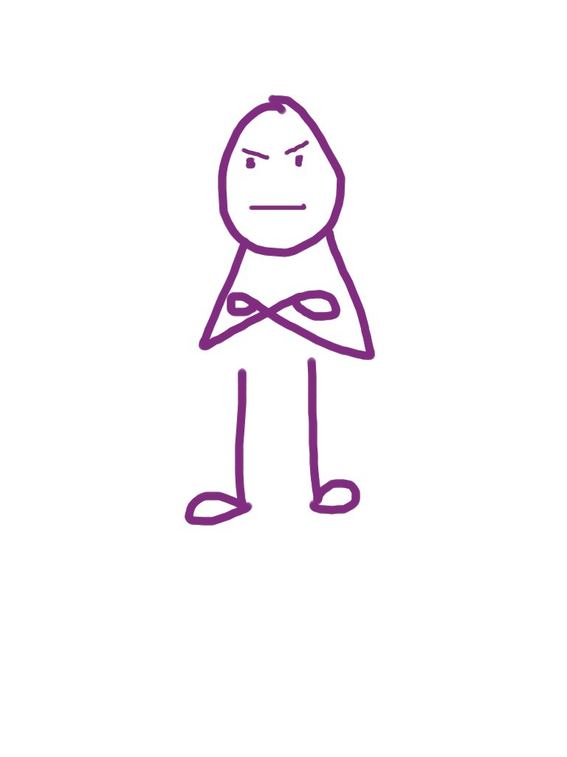
Entertain me!
Why is your work important?
Notes:
Another networking myth/ barrier – feeling you have to be the most interesting or entertaining person in the room. You don’t, but you do need to think about what the person listening will benefit from by listening to you.

Slide 18
Think of one person you would like to connect with
Think of THREE things that might interest them
Now identify one value you or your work will have for them

Slide 19
Potential for new projects or collaborations
New methods for existing/old questions
Opportunity to share facilities

Slide 20
Bridging worlds
Reducing risk of recruitment
Access to people or resources at UCC

Slide 21
To summarise
Think about the value, importance and relevance of your work
Start with headlines, then add detail
React to your audience
Smile!

Slide 22
What's in your networking toolkit?

Slide 23
What's in your networking toolkit?
Think of three great questions in your group that will stimulate conversations
Questions
Your enthusiasms
Your ears!
Into NEW pairs. If I gave you a day to do anything, how would you spend it?
Into pairs. One describes the last really interesting paper you read, the other listens carefully. Let the conversation flow...
Notes:
We looked at some of these exercises in other places in the workshop, but they are good reminders and you can practice with them to hone your networking skills.

Slide 24
Tips for shy networkers
Start small
Smile
Stop saying sorry
Ask questions
Be authentic
Share your passions
Listen
Give and take
Practice
Remember it won’t kill you
Use the power of “Who knows who?”
Follow up
http://www.cio.com/article/164300/How_to_Network_12_Tips_for_Shy_People

Slide 25
Networking is worth it because...
Facilitation of collaboration
Knowledge Exchange, Public Engagement and Impact
Filter information and save time
Feedback, inspiration and insight
Evaluation of your work through a 3rd party
Thanks to Louisa Lawes,
University of Edinburgh
for these ideas!
Notes:
Networking is like having a board of directors
http://www.cio.com/article/164300/How_to_Network_12_Tips_for_Shy_People
http://manchesterpgcareers.wordpress.com/2011/03/31/networking-for-shy-people/
http://sachachua.com/blog/p/6510/

